Slide 1


IMDB-Movie Analysis
From – Ayaluri Ayyappa

Slide 2
Project description
The objective of this project is to conduct a comprehensive analysis of the IMDB movie dataset.
The analysis focuses on several key aspects of the dataset, including movie genres, duration, language, directors, and budget.
By exploring these factors, we aim to understand their impact on the IMDB scores and financial success of movies.

Slide 3
Approach
To accomplish the project objectives, we followed a structured approach:
Data Preparation : : I began by downloading the dataset provided for the project. The dataset contains information about movie titles, genres, durations, languages, directors, budgets, gross earnings, and IMDB scores. I conducted a data cleansing activity and started working on this.
Data Analysis : Using Excel, we performed various analyses on the dataset to answer the questions outlined in the project details. This involved manipulating the data to extract relevant information, calculating descriptive statistics, and visualizing relationships between different variables
Report Generation : : Based on the analysis results, we created a detailed report to present our findings. The report includes insights derived from each analysis task, supported by visualizations and statistical summaries.

Slide 4
Tech STACK
For this project, WPS Office for data analysis. Excel's built-in functions and tools were instrumental in performing calculations, generating visualizations, and summarizing the results. Additionally, we utilized Google Drive to save and share the final report.

Slide 5
INSIGHTS

Slide 6
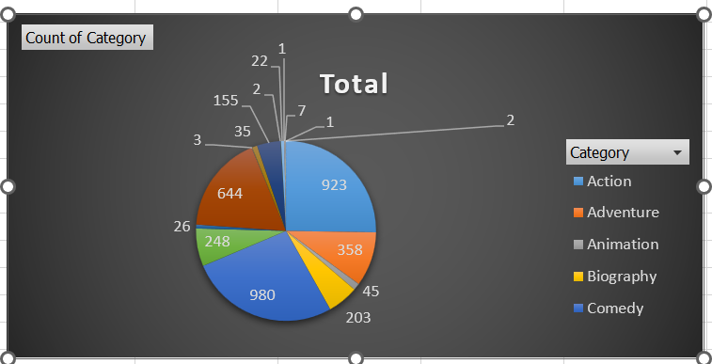
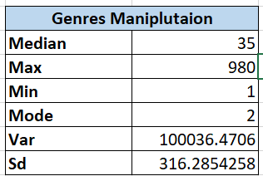
1. Determine the most common genres of movies in the dataset.
Movie Genre Analysis:
I identified the most common genres in the dataset and analyzed their impact on IMDB scores. Action, Biography, Crime, Comedy and Drama emerged as the most prevalent genres.

Slide 7
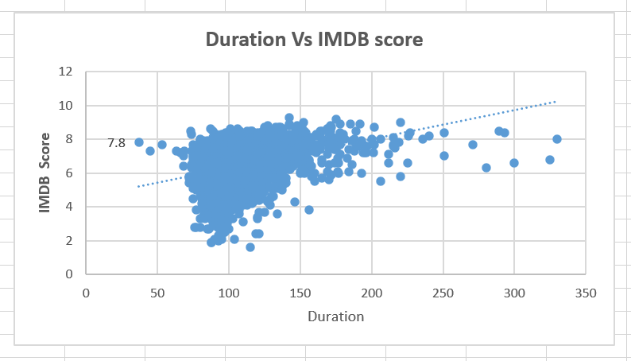
2.Analyze the distribution of movie durations and identify the relationship between movie duration and IMDB score.
Movie Duration Analysis: The distribution of movie durations varied widely, ranging from short films to lengthy epics. However, we observed a weak correlation between movie duration and IMDB score, suggesting that movie
From the scatter plot there is a slight possibilities to score 6 -8.5 IMDB score if movie duration is more than 250 minutes. With the help of trend line we can also predict IMDB score can increate with respect to duration of the movie.

Slide 8
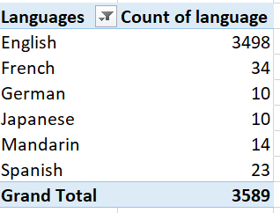
3. Determine the most common languages used in movies and analyze their impact on the IMDB score using descriptive statistics
Language Analysis : English was the predominant language in the followed by French and Greman . Interestingly, movies in languages other than English tended to have slightly lower IMDB scores on average, indicating potential biases in audience preferences.

Slide 9
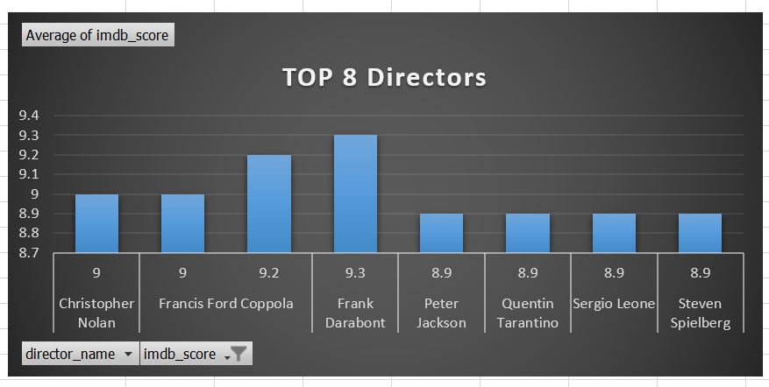
4. Identify the top directors based on their average IMDB score and analyze their contribution to the success of movies using percentile calculations.
Director Analysis: I identified top directors based on their average IMDB scores and analyzed their contribution to movie success. Directors such as Francis Ford Coppola and Frank Darabont consistently produced movies with high IMDB ratings, reflecting their strong influence on audience perception

Slide 10
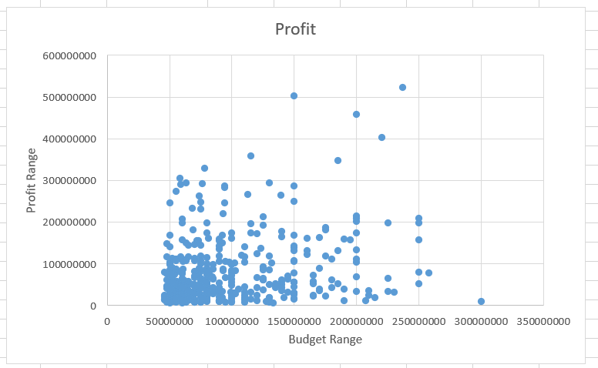
5 . Analyze the correlation between movie budgets and gross earnings, and identify the movies with the highest profit margin.
Budget Analysis : I explored the relationship between movie budgets and financial success by analyzing the correlation between budgets and gross earnings. While there was a positive correlation between the two variables, the strength of the relationship varied depending on other factors such as genre and director.

Slide 11
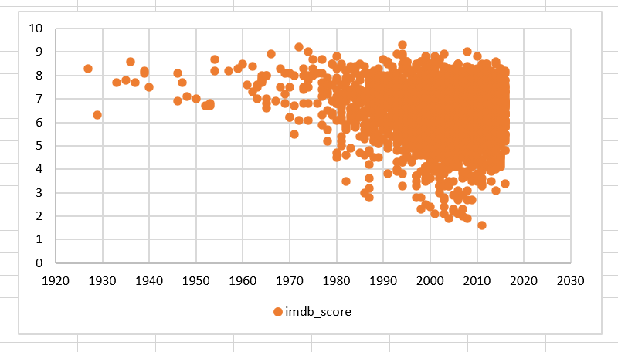
Additional Insights
Old Movies and IMDB Scores: While it's commonly believed that older movies tend to have higher IMDB scores, our analysis challenges this assumption. We found that while some old movies indeed have high scores, there is a wide variability in the ratings of older films. It's important to recognize that the quality of a movie is subjective and cannot be solely determined by its release year.

Slide 12
RESULT
Through this project, we gained valuable insights into the factors influencing movie ratings and financial performance. By analyzing genres, durations, languages, directors, and budgets, we were able to identify trends and patterns that shed light on audience preferences and industry dynamics. Our findings provide actionable insights for filmmakers, producers, and studios seeking to optimize their movie production strategies and maximize audience appeal.

